Slide 1
Propositional Logic

Slide 2
Logic in AI
Logic can be defined as the proof or validation behind any reason provided.
It is simply the ‘dialectics behind reasoning’.
It was important to include logic in Artificial Intelligence because agent (system) to think and act humanly, and for doing so, it should be capable of taking any decision based on the various available options.
There are reasons behind selecting or rejecting an option.

Slide 3
Types of logics in Artificial Intelligence
Two types of logics: Deductive logic and Inductive logic
In deductive logic, the complete evidence is provided about the truth of the conclusion made.
Here, the agent uses specific and accurate premises that lead to a specific conclusion.
Example: An expert system designed to suggest medicines to the patient because the person has so and so symptoms.
In Inductive logic, the reasoning is done through a ‘bottom-up’ approach.
The agent here takes specific information and then generalizes it for the sake of complete understanding.
Example: In the natural language processing, an agent sums up the words according to their category, i.e. verb, noun article, etc., and then infers the meaning of that sentence.

Slide 4
Propositional Logic
A proposition is a declarative statement which is either true or false.
It is a technique of knowledge representation in logical and mathematical form.
(a) The Sun rises from West
(b) 5 is a prime number.
In PL, symbolic variables are used to represent the logic.
PL consists of an object, relations or function, and logical connectives, called logical operators.
A proposition formula which is always true is called tautology, and it is also called a valid sentence.
A proposition formula which is always false is called Contradiction.

Slide 5
Syntax of propositional logic
There are two types of Propositions:
Atomic Propositions
Compound propositions
Atomic Proposition: Atomic propositions are the sentences which must be either true or false.
Compound proposition: Compound propositions are constructed by combining simpler or atomic propositions, using parenthesis and logical connectives (It is raining today, and street is wet)

Slide 6
Logical Connectives
Negation: A sentence such as ¬ P (negation of P) is a literal can be either Positive literal or negative literal.
Conjunction: A sentence which has ∧ connective such as, P ∧ Q is called a conjunction.
Disjunction: A sentence which has ∨ connective, such as P ∨ Q. is called disjunction, where P and Q are the propositions.
Implication: A sentence such as P → Q, is called an implication. Implications are also known as if-then rules. It can be represented as If it is raining (P), then the street is wet (Q), represented as P → Q
Biconditional: A sentence such as P⇔ Q is a Biconditional sentence,
If I am breathing (P), then I am alive (Q)

Slide 7
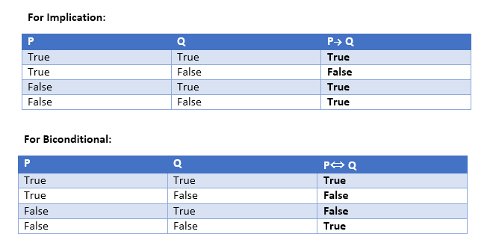

Slide 8
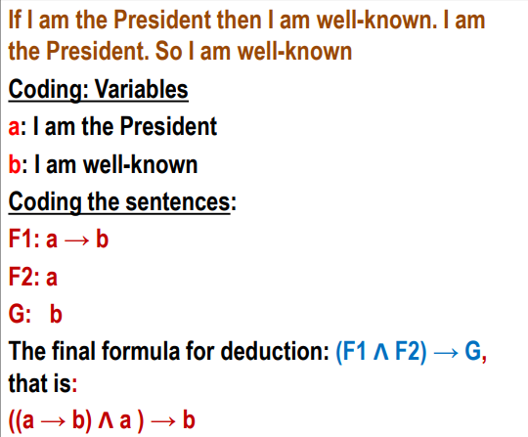
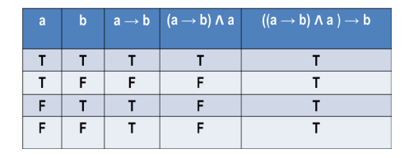
Deduction using Propositional Logic
Limitations of Propositional logic:
Cannot represent relations like ALL, some, or none with propositional logic. Example: All the girls are intelligent, Some apples are sweet.

